Slide 2
Note: After you download the slideshow, you may also need to download some videos from YouTube & add them into this PowerPoint. This tool can help you: Free YouTube Download
We present these messages in outdoor venues using the SonShineTent. Watch the video of our service that goes with this message, click here: http://campaignkerusso.org/?p=6780
We would love to know more about the people who download our lessons & sermons. We invite you to email us & let us know where & how you use them.
info@campaignkerusso.org

Slide 3
Welcome All

Slide 4
Let’s Begin with Prayer

Slide 6
Song: I Am a Friend of God
Video Goes Here Title: I Am a Friend of God Download Here:
https://youtu.be/qZVDUabb_xs

Slide 7
Song: Draw Me Close to You
Video Goes Here Title: Draw Me Close to You Download Here:
https://youtu.be/a_tdG9yM93A

Slide 8
Relationships are Important

Slide 9
This is Truly What God Wants!!!

Slide 10
What is our relationship with our Creator?

Slide 11
First let’s use the vowels to examine
…some wrong ideas about our relationship with God.

Slide 12
A is for ATM Machine
Some people think God is just there to give us things.

Slide 13
E is for Energy
Some people believe God is not a real person, but rather, just a force in the universe.

Slide 14
I is for Indifferent
Some people have a hard time believing God cares or even sees what happens to us.

Slide 15
O is for Ogre
Some people
Believe…
God is a big mean man in the sky who is just waiting to judge the Earth & punish the people for their sins.

Slide 16
U is for Unknowable
Some think God is just a big mystery we can never comprehend so why bother.

Slide 17
Sometimes
Y
(As in Why God?)
These people resent God for something bad that happened which they don’t understand.

Slide 18
Most People Just Do This

Slide 19
There are Three
Wonderful Ways we can Relate to God

Slide 20
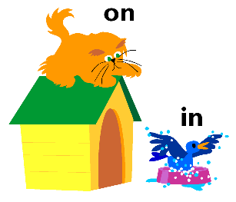
First, Believers have a Positional Relationship with Jesus… is it…
What is our positional relationship to Christ?

Slide 21
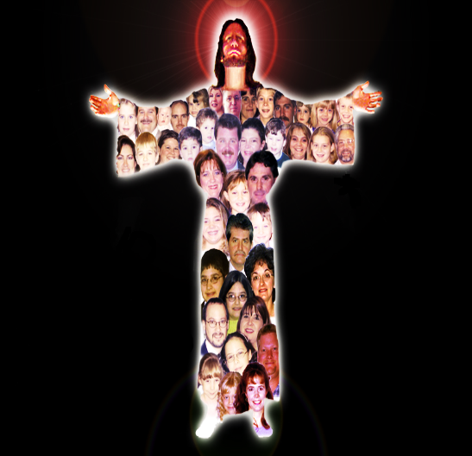
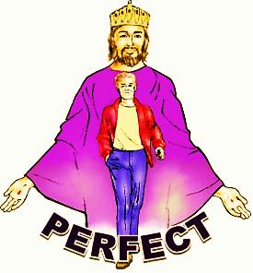

Slide 22
“There is therefore now no condemnation for those who are IN Christ Jesus.” Rom. 8:1
“Therefore, if anyone is IN Christ, he is a new creation. The old has passed away; behold, the new has come.”
2 Cor. 5:17
"…we are IN Him that is true, even IN His Son Jesus Christ." 1 John 5:20

Slide 23
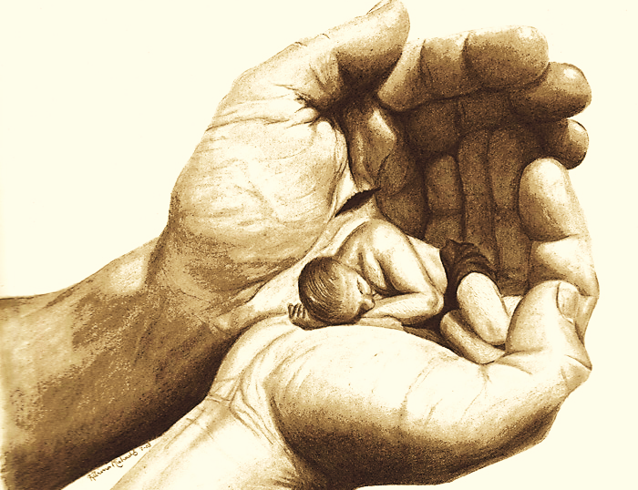
Second, Believers have a Legal Relationship with God.
Believers are not mere acquaintances, but are sons & daughters of God. His legal children!

Slide 24
“… you have received the Spirit of adoption as sons, by whom we cry, “Abba! Father!” …we are children of God, and if children, then heirs…” Rom. 8:15-17
“…‘Come, you who are blessed by my Father, inherit the kingdom prepared for you from the foundation of the world.” Mat. 25:34

Slide 25
Being God’s Child has it’s Privileges

Slide 26
Third, Believers have a Heart-Felt Relationship.
But FRIENDS of God!
No Longer Strangers

Slide 27
“No longer do I call you servants, for the servant does not know what his master is doing; but I have called you friends…”
John 15:15
“and the Scripture was fulfilled that says, “Abraham believed God, and it was counted to him as righteousness”—and he was called a friend of God.” James 2:23
“Greater love has no one than this, that someone lay down his life for his friends.”
John 15:13

Slide 28
The Three Ways We Relate to God
Positional:
Not Out but In Christ
Legal:
Not an Acquaintance but a Child & Heir
Heart-Felt:
Not a Stranger but
a Friend of God

Slide 29
Finally, The suffix, ‘ship’ means, ‘to continue, to abide’
Once we begin a relation‘ship’ with God, we must continue to relate with God. Ships are made to go forward.

Slide 30
“…continue in the faith grounded and settled… not moved away from the hope of the gospel…” Col. 1:23

Slide 31
Song: By Your Side
Video Goes Here Title: By Your Side Download Here:
https://youtu.be/gsAf5RSbE70

Slide 32
Is Jesus
Speaking to You?
“They said to each other, ‘Did not our hearts burn within us while he talked to us on the road, while he opened to us the Scriptures?’”
John Wesley Said:
“…the preacher was describing the change which God works in the heart through faith in Christ and I felt my heart strangely warmed.”
Jesus makes His presence Known by a small voice!

Slide 34
What is the Sinner‘s Prayer?
This is a prayer we can pray when we are ready to admit we are sinners and need Christ’s forgiveness.
It must be prayed with faith in our hearts and a readiness to have a life-changing encounter with Jesus Christ.

Slide 35
A prayer of faith → Pray this prayer if :
If you never have before
You have in the past, but you think it would mean more today
You have been walking afar off and you want to come back
You want to set an example & show others how it is done
You just like to give your heart to Jesus again & again
Faith

Slide 36
We Declare Our Faith Publicly Because Jesus Declared His LOVE Publicly
“If you stand before others and are willing to say you believe in me, then I will tell my Father in heaven that you belong to me.” Mat 10:32

Slide 37
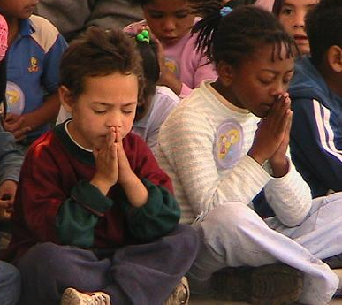
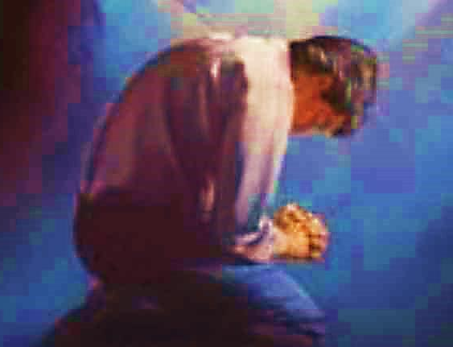
Three Important Questions
Do you want to know Jesus as your Savior right now?
Do you believe He died to save you from your sins & that He rose from the dead?
Do you believe that He is here, waiting to save you right now?

Slide 38
The Prayer of a Sinner Turning to Jesus
Dear Jesus, I know that I have sinned against You and that my sins separate me from You.
I am truly sorry.
Right now, I turn away from my sinful past .
Please forgive me, and help me to keep from sin.
I believe You died for my sins.
I Believe You rose from the dead, you are alive, and you hear this prayer from my heart.
I invite You Jesus to be both my Savior and the Lord of my life.
I want You to rule my life from now on.

Slide 39
“But some people did accept him. They believed in him, and he gave them the right to become children of God.”
John 1:12

Slide 41
“If you openly say, ‘Jesus is Lord’ and believe in your heart that God raised him from death, you will be saved.”
Rom. 10:9
What did you learn today?
What about our relationship with God?
What have you been thinking about God lately?
What do you want to tell others about Jesus?

Slide 42
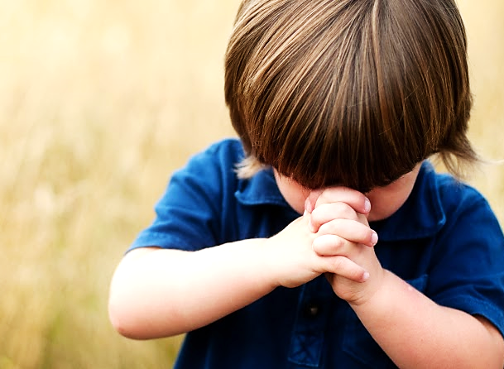
Let’s Close in Prayer

Slide 43
Note: After you download the slideshow, you may also need to download some videos from YouTube & add them into this PowerPoint. This tool can help you: Free YouTube Download
We present these messages in outdoor venues using the SonShineTent. Watch the video of our service that goes with this message, click here: http://campaignkerusso.org/?p=6780
We would love to know more about the people who download our lessons & sermons. We invite you to email us & let us know where & how you use them.
info@campaignkerusso.org

